Slide 1
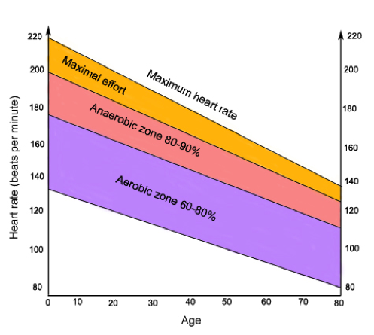
KS3 Fitness Assessment Card
Fitness Components & Testing (year 7)
Component | Fitness Test
Body Composition | BMI Skin-Fold Testing BIA
Speed | 30m Sprint Test
Flexibility | Sit and Reach Test
Muscular Endurance | 1-Minute Sit-Up Test 1-Minute Press-Up Test
Muscular Strength | Hand Grip Dynamometer
Aerobic Endurance | Multi-Stage Fitness Test 12 Minute Cooper Run
Balance | Stork Balance Test
Coordination | Alternate Hand Wall Toss Test
Power | Vertical Jump Test
Reaction Time | Ruler Drop Test
Agility | Illinois Agility Run Test
Methods of Training (year 8)
Method | Component of Fitness
Continuous Training | Aerobic Endurance
Fartlek Training | Aerobic Endurance
Interval Training | Speed & Aerobic Endurance
Resistance/Weight Training | Muscular Strength and Muscular Endurance
Circuit Training | Muscular endurance, Strength and/or Cardiovascular Fitness
Plyometric Training | Power
Flexibility Training | Static, Ballistic, PNF
Principles of Training (year 9)
Principle | Application
Frequency | Frequency is increased by training a greater number of times each week.
Intensity | Intensity is increased by lifting a greater resistance, such as with weight training, or by training at a higher percentage of maximum heart rate.
Time | Time can be manipulated by training for longer, reducing recovery times or by completing a greater number of sets or repetitions (also known as reps).
Type | Type of training is manipulated by offering a variety of training types and experiences to the athlete by combining training methods.
Specificity | Training should be matched to the requirements of the activity that the performer is involved in.
Progressive Overload | The frequency, intensity, time and/or type of exercise are gradually increased to ensure levels of performance improve.
Adaptation | Occurs during the recovery period after the training session is completed.
Variation | Using a variety of training methods consistently challenges your body.
Reversibility | Any adaptation that takes place as a result of training will be reversed when you stop training. If you take a break or don’t train often enough you will lose fitness.
Individual Needs/ Differences | No two exercise programmes should be exactly the same because they should be designed to meet the needs of an individual.
Training Zones (year 8)

Slide 2
KS3 Fitness Assessment Card: Grading Criteria
 | Fitness Components | Training Methods | Principles of Training | Goal Setting | Safety
Olympian (Skillful) | Able to define each component of fitness, name the appropriate fitness test(s) and the relevant method of training to improve each component. | Able to explain all methods of training, as well as providing multiple examples of each (with specific athletes) and links it to the appropriate component(s) of fitness. | Able to apply the principles of training to their training/exercise to ensure it is successful and meets their individual goals. Able to explain each principle in detail without support. | Able to set themselves specific goals and is able to fully justify their choices when questioned regarding their training/exercise programme. Can also set appropriate goals for the peers and explain them. | Able to demonstrate an excellent knowledge of all areas within their fitness lessons. Able to provide advice and instructions to their peers to allow them to access the resources effectively and safely.
Gold (Able) | Able to define the vast majority of components, name the appropriate fitness test(s) and the relevant method of training to improve each component. | Able to explain all methods of training, as well as providing examples. Can link the vast majority to the appropriate component(s) of fitness. | Able to apply the principles of training to the majority of their training/exercise to ensure it is successful and meets their individual goals. Able to explain each principle in without support. | Able to set themselves appropriate goals and is able to justify their choices when questioned regarding their training/exercise programme. Can also set appropriate goals for the peers and them with a small amount of prompting. | Able to demonstrate a very good knowledge of all areas within their fitness lessons. Feels confident when talking to the peers about the resources and can provide instructions and advice.
Silver (Developing) | Able to define most of the components, name the appropriate fitness test(s) and the relevant method of training to improve each component. | Able to explain all methods of training with little support. Can provide examples. Can link the vast majority to the appropriate component(s) of fitness with little support. | Able to apply most of the principles of training to the their training/exercise to ensure it is successful and meets their individual goals most of the time. Able to explain each principle with little support. | Able to set themselves appropriate goals and is able to justify their choices when questioned. Can relate to their training/exercise with some support. | Shows a good knowledge of many areas within their fitness lessons. Conducts themselves well and is able to provide advice to their peers regarding the activities.
Bronze (Emerging) | Able to define some of the components, name the appropriate fitness test(s) and the relevant method of training to improve each component. | Able to explain methods of training with little support. Can provide some examples. Can link the vast majority to the appropriate component(s) of fitness with support. | With support, is able to apply some of the principles of training to the their training/exercise to ensure it is successful and meets their individual goals. Able to explain each principle with some support. | Able to set themselves mostly appropriate goals and is able to justify their choices with support when questioned. Can relate to their training/exercise with support. | Shows some knowledge of the areas of study within their fitness lessons. Can follow direct instruction well and is comfortable working with their peers within the lesson.
Use the above criteria to self and peer assess during PE lessons. Identify what steps you can take to achieve the next level.

