Slide 1
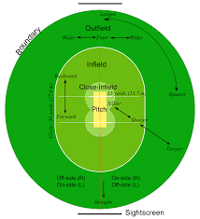
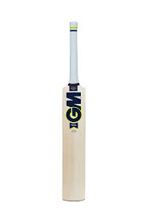
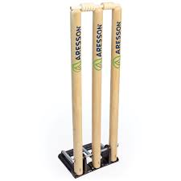
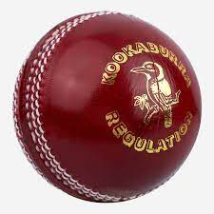
KS3 Cricket Assessment Card: Rules, Regulations, and Equipment
Equipment (1)
Cricket Balls Cricket Bats Stumps and Wickets Crease/Pitch Umpires Scorers
Key Terms (2)
Bowling Fielding Batting Throwing Catching Runs Over Innings Offside Legside Square leg
Key Rules (3)
Each team is made up of 11 players. To score a point a batter must hit the ball and run to the other end of the pitch. If the ball is hit to the boundary then four runs are awarded, if the ball has touched the floor. Six runs are awarded if the ball has gone straight over the boundary, line in the air. A no ball will be called if a bowler bowls the ball above head height after bouncing or waist height from a full toss. A wide will be called if a blower bowls the ball wide of the markings on the pitch indicating the width. Players can be given out by being caught, stumped, bowled, leg before wicket (LBW), hitting own stumps and being run out. Two umpires, one stood at the end of the pitch as one at square leg.

Slide 2
KS3 Cricket Assessment Card: Grading Criteria
 | Skill 1: Catching | Skill 2: Throwing | Skill 3: Fielding | Skill 4: Bowling | Skill 5: Batting | Game Situation
Olympian | Able to catch consistently with excellent technique and very high levels of success. Confident to catch the ball with one hand, rather than two. | Demonstrates confidence when throwing over a variety of distances. Able to pick up and throw in one action to save time. | Demonstrates outstanding fielding ability in variety of positions. Alters fielding position to back up other players. Shows an awareness of the movements of the batter. | Demonstrates excellent control when bowling at a range of speeds. Able to defeat the batter or limit their scoring opportunities with consistently accurate deliveries. Makes very few errors and very rarely bowls a no ball. | Demonstrates excellent execution of all shots and correctly selects them according to the speed and line of ball. Good awareness of field placings and their strengths. Makes very few errors. | Excellent level of skill in all areas of the game and makes very few errors. Leads team mates and can set appropriate fields for different batters. Anticipates changes in the game and react quickly.
Gold | Excellent technique demonstrated when catching both underarm and overarm throws with high levels of success. | Excellent technique for both underarm and overarm throws. The vast majority of throws are performed accurately and with success. | Able to stop, catch and pick up ball successfully most of the time. Usually able to anticipate the ball and reduce the scoring opportunities for the other team. | Able to demonstrate a good bowling action. Controls both line and pace consistently well. Occasionally uses spin or deception to trouble the stronger batter. | Able to play a wide range of shots off both leg and offside. Shows an awareness of field placings and can score accordingly. | Able to influence the game in all five of the areas. Shows a high level of skill and understanding of tactics. Makes few errors and assists team mates.
Silver | Able to consistently both underarm and overarm throws of varying distances. Lacks confidence when the ball is travelling at speed. | Can throw and catch with more confidence over a variety of distances but sometimes lack accuracy. Underarm and overarm throws show good technique. | Sometimes able to anticipate the pace and direction of the ball in order to retrieve it. | Able to bowl using the correct action and appropriate footwork. Able to consistently bowl in good areas. Occasionally bowls a ‘no ball’. | Able to play a straight drive appropriately. Attempts to play the ball into gaps and run well between the posts. | Able to demonstrate a strong influence in one of the five areas: catching, throwing, fielding, bowling or batting in a game situation. Aware of the rules and tactics and how they affect the game.
Bronze | Able to occasionally but with limited success. Demonstrates confidence when attempting to catch underarm throws, but unsuccessful for overarm throws. | Able to throw successfully over short distances when given time. Underarm throw is preferred method. | Able to perform a long barrier in isolation. Begins to put hands and body into the correct positions when fielding. | Able to demonstrate a basic bowling action, bowling a reasonable line and pace. The bowl lacks control and consistency. | Demonstrates a good stance and grip. Makes good contact with the ball but cannot aim shot into certain areas of the field. | Able to exert some influence over the game. Performs basic skills but can be affected by pressure. Some understanding of the rules and tactics involved.
Use the above criteria to self and peer assess during PE lessons. Identify what steps you can take to achieve the next level.

