Slide 1
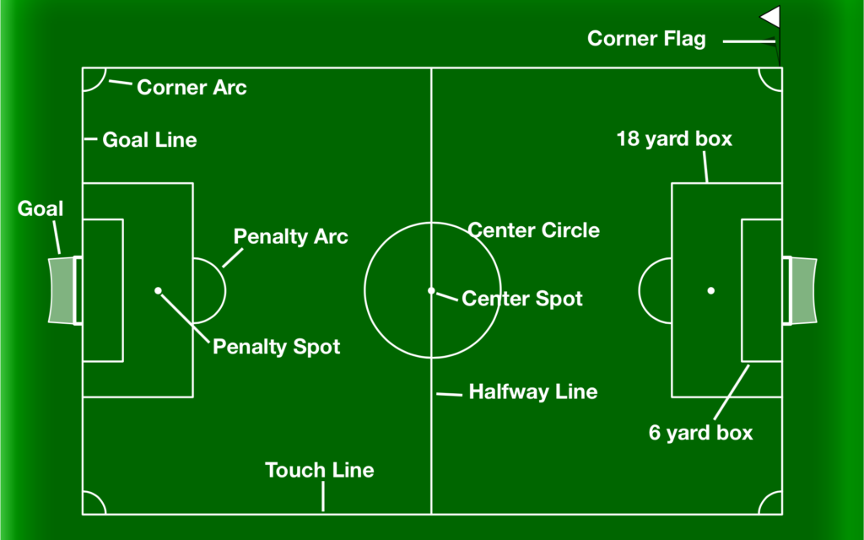
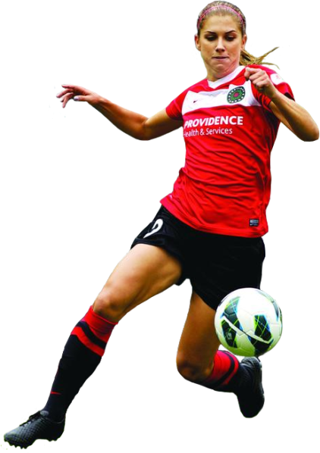
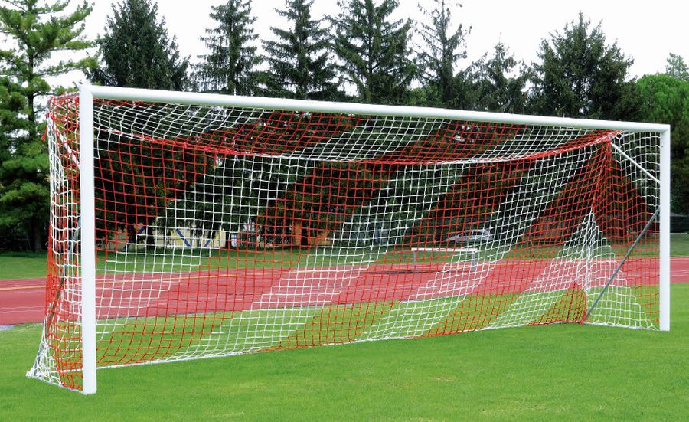
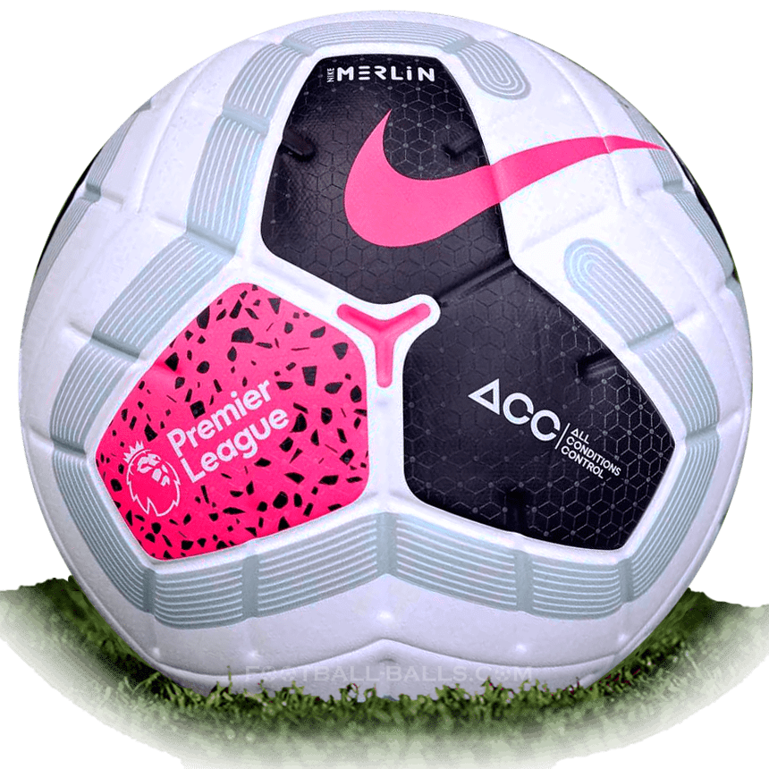
KS3 Football Assessment Card: Rules, Regulations, and Equipment
Equipment (1)
Football Bibs or Kit Pitch (Correct Markings) Goal Posts & Nets Corner Flags Whistle
Key Terms (2)
Attack Defence Dribbling Passing Goal Offsite Corner Cross Free kick Penalty Foul Tackle
Key Rules (3)
A match consists of two 45 minutes halves with a 15 minute rest period in between. Each team can have a minimum of 11 players (including 1 goalkeeper who is the only player allowed to handle the ball within the 18 yard box) and a minimum of 7 players are needed to constitute a match. Each team can name up to 7 substitute players. Substitutions can be made at any time of the match with each team being able to make a maximum of 3 substitutions per side. If teams are still level after extra time then a penalty shootout must take place. The whole ball must cross the goal line for it to constitute as a goal. For fouls committed a player could receive either a yellow or red card depending on the severity of the foul; this comes down to the referee’s discretion. The yellow is a warning and a red card is a dismissal of that player. Two yellow cards will equal one red. Once a player is sent off then they cannot be replaced. If a ball goes out of play off an opponent in either of the side lines then it is given as a throw in. If it goes out of play off an attacking player on the base line then it is a goal kick. If it comes off a defending player it is a corner kick.

Slide 2
KS3 Football Assessment Card: Grading Criteria
 | Skill 1: Passing | Skill 2: Dribbling | Skill 3: Control | Skill 4: Shooting | Skill 5: Tackling | Game Situation
Olympian (Skillful) | All types of pass are performed with exceptional results. Good timing and pace are always evident. Able to pass on move using inside and outside of foot. | Shows high level of balance and control when dribbling at pace. Can use either foot with confidence. Able to wrong foot opponent by using upper body or step overs. | Able to consistently control ball with all body parts when under pressure and when moving. Always creates space with first touch of ball. | All types of shots are performed with exceptional results. Good timing and pace are always evident. Able to shot on move using a variety of techniques. | All types of tackles are performed with exception results. Tackles are performed with excellent timing and are effective within competitive situations. | Exerts significant control over game. Outstanding level of skill, tactical awareness & anticipation. Few errors even when under competitive pressure. Leads team both physically and verbally.
Gold (Able) | Consistently passes the ball accurately whilst on the move. Able to use a wide variety of passes appropriately. | Able to beat opponent on either side at pace, can use both feet but still prefers towards stronger one when under pressure. Can use a feint or dummy to beat defender. | Able to control ball with all body parts and can reproduce this in pressurised situations. Shows understanding of creating space with first touch. | Consistently produces accurate shots within competitive situations. Able to use a wide variety of shot techniques appropriately. | Consistency performs the correct technique when tackling in a range of situations. High level of success when tackling in a competitive situation. | Exerts a strong influence on the game in attack & defence. Makes few unforced errors and assists team mates physically and verbally. High level of skill and tactical awareness.
Silver (Developing) | Able to pass ball accurately whilst on the move. Demonstrates correct timing and timing passing the ball over various distances. | Can run at and beat opponent on chosen side with close control of the ball and with good success. Able to change direction easily but tends to use dominant foot only. | Able to control ball with dominant foot so it is ideal position for dribble. Can use chest and thigh but ball does not always drop in desired position. Needs to cushion ball more effectively. | Able to shoot accurately whilst on the move. Demonstrates correct technique over various distances and with varying levels of challenge. | Able to use correct technique when performing a standing tackle with more consistency. | Shows some ability to influence game. Understands the differing roles of attack & defence and can perform either. Can play in a variety of positions effectively.
Bronze (Emerging) | Passes accurately with correct part of foot. Pass is often not weighted correctly. | Shows more control, ball kept within easy reach but sometimes loses control. Dominated by inside of the foot. | Able to control ball in isolation but tends to use sole of foot. Fails to remove pace of ball and struggles when ball arrives at different heights. Still turns away from the ball at times. | Shoots accurately with correct part of foot. Shot is often not weighted correctly. | Uses correct technique to perform a standing tackle occasionally with limited success. | Starts to become more effective. Plays a small role within the team performance, demonstrating some simple skills but still prefers to let others take the lead.
Use the above criteria to self and peer assess during PE lessons. Identify what steps you can take to achieve the next level.

