Slide 1
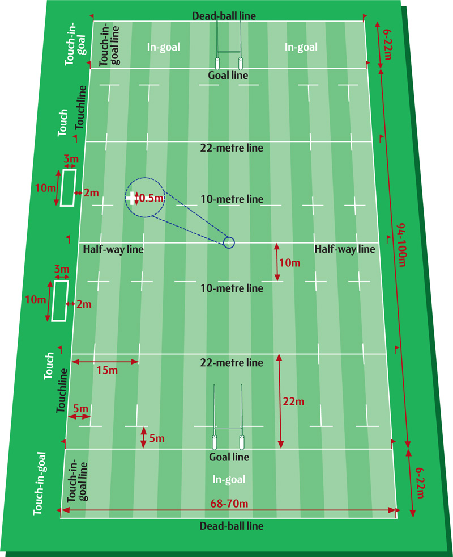
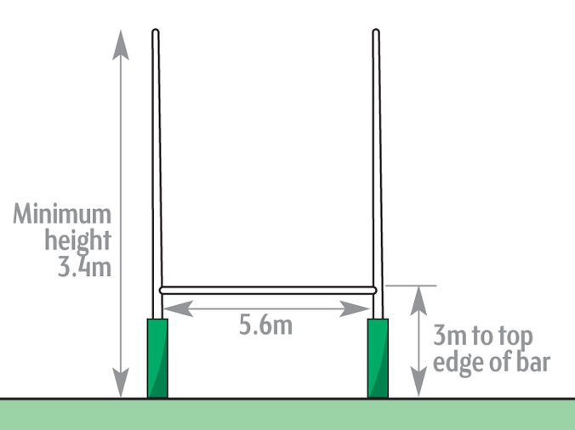
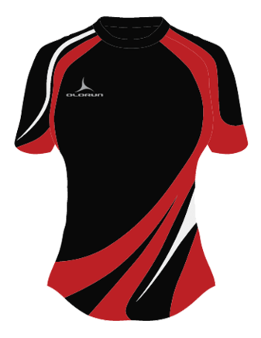
KS3 Rugby Assessment Card: Rules, Regulations, and Equipment
Equipment (1)
Pitch (Correct Markings) Rugby Ball Bibs or Kit Posts Gum Shield Whistle
Key Terms (2)
Attack Defence Ruck Maul Lineout Scrum Conversion Try Drop Kick Offside Kick Crouch Touch Engage
Key Rules (3)
The game is broken down into two 40 minute halves with a 10 minute rest period in between. The game carries no stoppage time and will end exactly on 80 minutes. Each team can start with 15 players and up to 7 substitutes. Players that have left the field are only allowed to return if they have been treated for an injury. The game will stop if a player is fouled, the ball goes out of play or a try or drop goal is scored. The defending team must tackle a player by grabbing a hold and pulling them to the floor. A tackle cannot be made above shoulder height and doing so will cause the referee to award a foul. Once the ball goes into touch a line out is called. A successful conversion, penalty or kick at goal only occurs when the player manages to kick the ball through the top section of the goal. Attacking players must remain behind the ball whilst active or run the risk of being called offside. Players not interfering with play can be in front of ball but must get back behind the ball before then again interfering with play.

Slide 2
KS3 Rugby Assessment Card: Grading Criteria
 | Skill 1: Passing | Skill 2: Receiving | Skill 3: Tackling | Skill 4: Contact | Skill 5: Support Play | Game Situation
Olympian (Skillful) | Full control of the pass whatever the pace of running. Defenders don't force any errors & long passes are accurate. Is able to spin pass from the ground. | Always in support in the right place and judges timing and angle of support runs. | Tackles from front/side/rear all made cleanly and puts attacker under pressure to control ball. | In all contact situations correct decisions are instant & all opposition are physically out played so possession is maintained & under control. | All play is done at speed: passes, side-steps, scissors, dummies and avoiding tackles. Switches from attack to defence to attack etc. easily. | Excellent tactical awareness & applies all rules correctly, controlling a game with best decisions & very good individual skills. Is able to lead & influence team mates even under pressure. If needed tactical kicking is performed accurately.
Gold (Able) | Is accurate running at full pace and times the pass in all situations. Can hand off defenders & side steps to avoid being tackled. | Reads the game well and supports in the right position even after a few tackles and phases of possession. | All tackles are made cleanly & use of ABC & channelling needs no prompting. Avoids hand-offs. | Keeps possession in virtually all contact situations either as carrier or support player. | Links well between players at contact and others in space. Shows loops & good support in space at good speed. Demonstrates attacking & defensive positions when necessary. | Very few unforced errors in attack & defence. Good tactical awareness under pressure & can play in different positions. In best position shows a high level of skill & success. Knows most of the rules well & where necessary can demonstrate kicking.
Silver (Developing) | Can pass the ball along a back line at full pace. Shows a change of pace to get behind the ball & accelerate to take the ball on the run. In 2 v 1 will time the pass well & not panic. | Follows play well & often in the correct position when judgement is needed. Doesn't get in front of the ball. | Consistently good technique in the game situation. Understands key points to a side-on tackle so can adapt this to a front-on tackle. | Makes correct decisions at Contact: ruck (ground/'scrummage' over) or brace & unload and stops opposition getting the ball. | Confident with the ball in space & passes well in non-contact situations. Often passes to someone in a better position. Shows some understanding of attacking & defending positions. | More involved & vocal in games. Reads & influences a game with good basic skills & decision making. Can out play opposition & happy with contact in attack & defence. Shows good knowledge of offside & rules of contact.
Bronze (Emerging) | Can pass with some accuracy when running below full speed but can panic when defenders pressure. Doesn’t look before passing. | Behind the ball in simple drills but often gets in front of the ball as play develops. | Will attempt tackles in controlled drills. In a game when attackers are active, technique easily goes wrong trying to tackle with arms instead of shoulders. | In 2 v 2 or 3 v 3 understands brace & unload or ruck (ball on ground/'scrummage' over) but doesn't always get technique right & the ball isn't always in control. | Has some individual skills but links with others poorly. Often runs with the ball under one arm making passes difficult. | Gets involved in the game at times & can show basic skills but not if put under too much pressure from defenders.
Use the above criteria to self and peer assess during PE lessons. Identify what steps you can take to achieve the next level.

