Slide 1
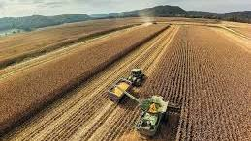
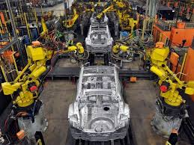
AQA ECONOMICS KNOWLEDGE ORGANISER: YEAR 10
1.2 Resource allocation
The price mechanism
Economic Sectors
A market is where buyers & sellers come together to exchange goods & services.
Buyers & sellers will interact to set a price which is based on the demand for or supply of scarce resources
Price is used to distribute the good/service: a price the buyer is willing to pay and a price the seller is willing to sell at, this is known as the price mechanism.
Primary sector: related to natural resource
Primary sector is the start of the chain of production
Secondary sector: related to the manufacturing of natural resources
Secondary sector is the second stage of the chain of production
Demand
Supply
Law of Demand:
As prices fall, the quantity demanded increases.
Firms will charge a higher price & still sell it
As prices rise, the quantity demanded decreases, therefore firms will charge a lower price to sell it
Law of Supply:
If supply increases, this will lead to a fall in price: firms will have too much and reduce the price to sell it.
If supply decreases, this will lead to a rise in price as it becomes more scarce the firm can raise its price
Tertiary sector: activity providing a service
The UK is more reliant on this sector than any other G7 country
Specialisation
Division of labour
Employees: become experts in their jobs
Firms: become experts in their field
Countries: concentrate on specific industries
Specific tasks are allocated out to each member of staff
Low skilled & repetitive
Highly skilled & motivated
Efficient & increased productivity
Competitive advantage
Factor markets
Where factor inputs are bought & sold
Land Labour
Capital Enterprise
Product markets
Where goods/services are bought & sold
B2B: business to business
B2C: business to consumer

