Slide 1
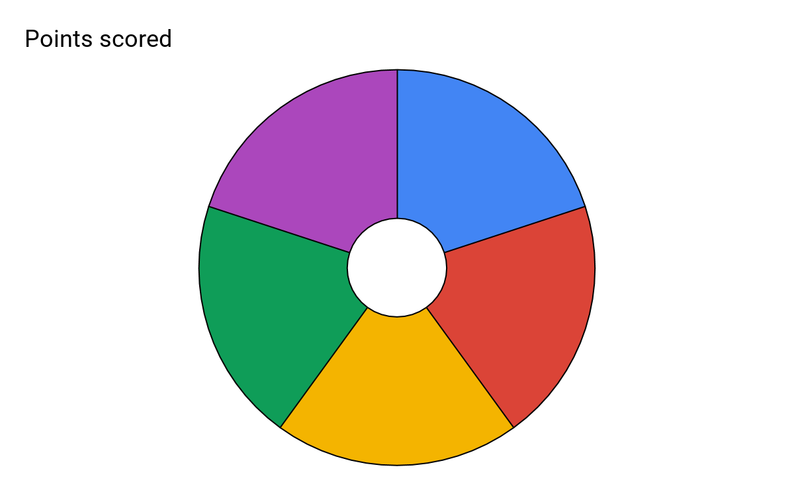
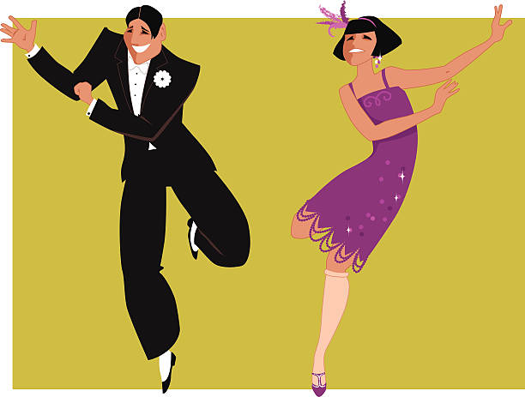
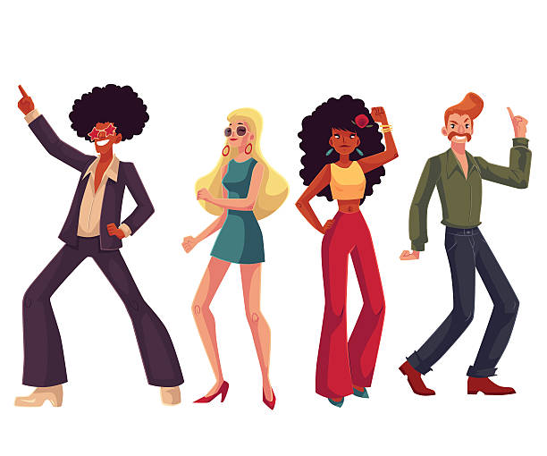
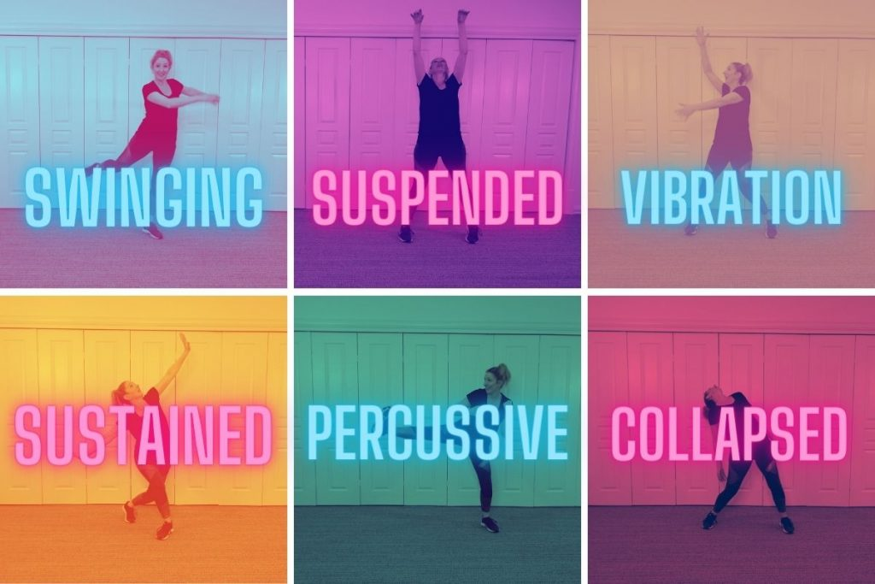
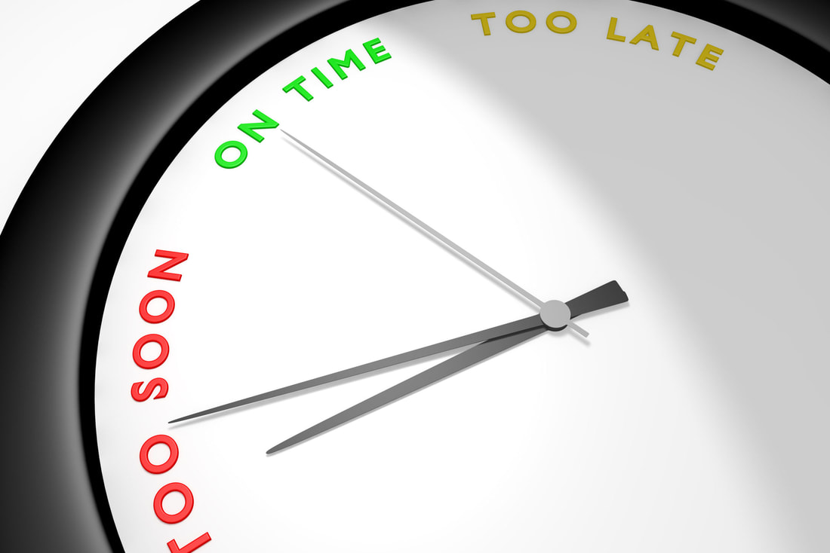
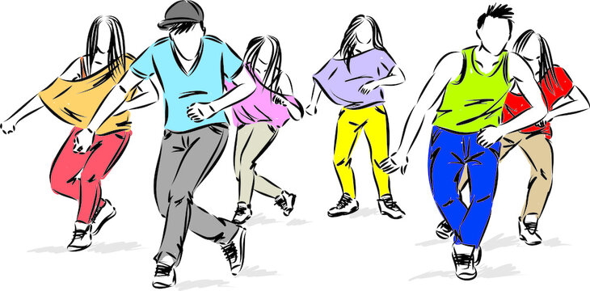
Subject: Performing Arts: Dance
Topic: Dancing Through The Decades Year: 7
1920s Swing: Swing dance is an ‘umbrella’ term that covers lots of individual styles and techniques. Swing dance combines ballroom and jazz with focus on fast footwork, partner work and musicality. Key Styles:
Charleston
Jive
Tap
Lindy Hop
Swing dance dominated the 20s-50s and was regularly performed at vaudevilles, clubs, dance marathons and balls. Swing dance was made popular by famous performers such as Fred Astaire, Judy Garland, Ginger Rogers and Gene Kelly who performed swing and tap dance in movies and vaudeville shows.
1920’s Charleston: The Charleston is a dance named after the harbor city of Charleston, South Carolina. The peak year for the Charleston as a dance by the public was mid-1926 to 1927.The dance was first seen to be performed on the streets in America and in nightclubs, but the first official onstage viewing was seen on an all-black Broadway musical called ‘Runnin Wild’. Key Features of Charleston:
Toes-in, heels-out twisting steps (footwork)
Inverted knees
Swinging arm movements
The 5 Key skills/knowledge for this unit.
1970s Disco: Disco dance was heavily influenced by jazz, samba, cha cha and tango. Disco reached its popularity peak with the release of ‘Saturday Night Fever’. Disco dancing was a style that emerged from nightclubs in Philadelphia and New York City and focussed on the musicality of the fast beats in funk music.
Key features:
Large hip movements
Pivot turns
Pointing fingers
1920s
Swing
1970s
Disco
5
Timing
1990s
Hip-Hop
Dynamic
Awareness
1990s Hip-Hop: Hip hop dance falls under the umbrella term for Street Dance. It begun to develop during the 1970’s, inspired by Hip-Hop music & the movements of African dancing. Hip Hop was a style for individuals without any professional dance training but with a natural instinct for movement. Throughout the 90’s Hip-Hop became more of a commercialised style featuring in music videos and films.
Key features:
Bounces and Rocks
High Energy
Social Grooves
Dynamic Awareness: Noticing and applying the correct quality to each movement. For example: sharp, soft, fluid etc.
Timing: Performing the correct movement at the correct time. This should be in time with your group.
Understanding the beat of the music and how to perform in the correct counts.

Slide 2
Subject: Performing Arts: Dance
Topic: Dancing Through The Decades Year: 7
What is a Decade? A decade is a period of ten years. Dance has evolved over time and has been influenced by many things such as music, art and culture. Over time, dance has been a way to socialise, to have fun, to distract from harsh realities of life events, to celebrate, to express emotions and to show off skills and techniques. Throughout the decades we have seen the change from vaudevilles and dance halls to the introduction of television, films, flash mobs, music videos and social media with the addition of new styles and trends.
Key Vocabulary: Choreographic Devices
Keyword | Definition
Canon | Performing the same movement one after another.
Unison | Performing the same movement at the same time
Formation | The position you stand in to perform.
Levels | The height at which you perform your movement
Repetition | Repeating the same movement or phrase more than once
Accumulation | Gaining dancers as a phrase is performed
Juxtaposition | Showing a contrast on stage. This can be applied using speed or style etc
Fragmentation | Dividing the dance into smaller chunks and reordering this to create a new phrase
Key Vocabulary: Physical and Performance Skills
Keyword | Definition
Extension | The lengthening of body parts outwards. E.g. Straight arms and pointed toes
Flexibility | The range of movement possible in the joints/muscles
Coordination | The ability to use different parts of the body together smoothly and efficiently.
Posture | The way the body is held
Stamina | Ability to maintain physical and mental energy over periods of time.
Timing | Performing the correct movement at the correct time. This should be in time with your group
Musicality | How in time you are with the music
Energy | How much physical effort you apply to the performance
Facial Expressions | Animating the face to engage with your audience/communicate the theme of your performance
Projection | Projecting your movements outwards into the space with appropriate energy.
Dynamic Awareness | Noticing and applying the correct quality to each movement. For example: sharp, soft, fluid etc.
Timeline | Dance Style
1920s | Swing Dance
1930s | Jive
1940s | Mambo
1950s | Cha Cha
1960s | Locking & Popping
1970s | Disco, Stepping, Salsa
1980s | Jacking & Voguing
1990s | Hip Hop & Iconic music videos (vogue, macarena, running man, electric slide)
2000s | Krumping, electro dance, flash mobs
2010s | Viral trends (dougie, floss, watch me)

