Slide 1
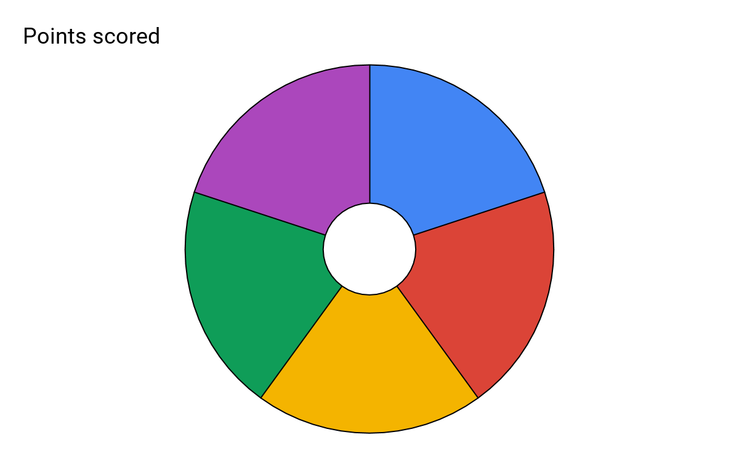
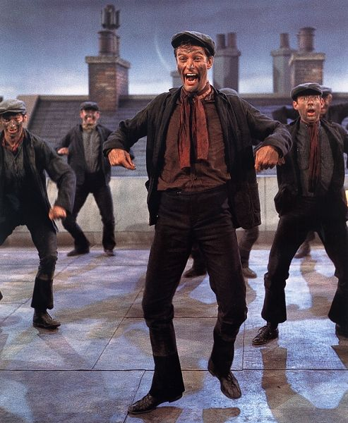
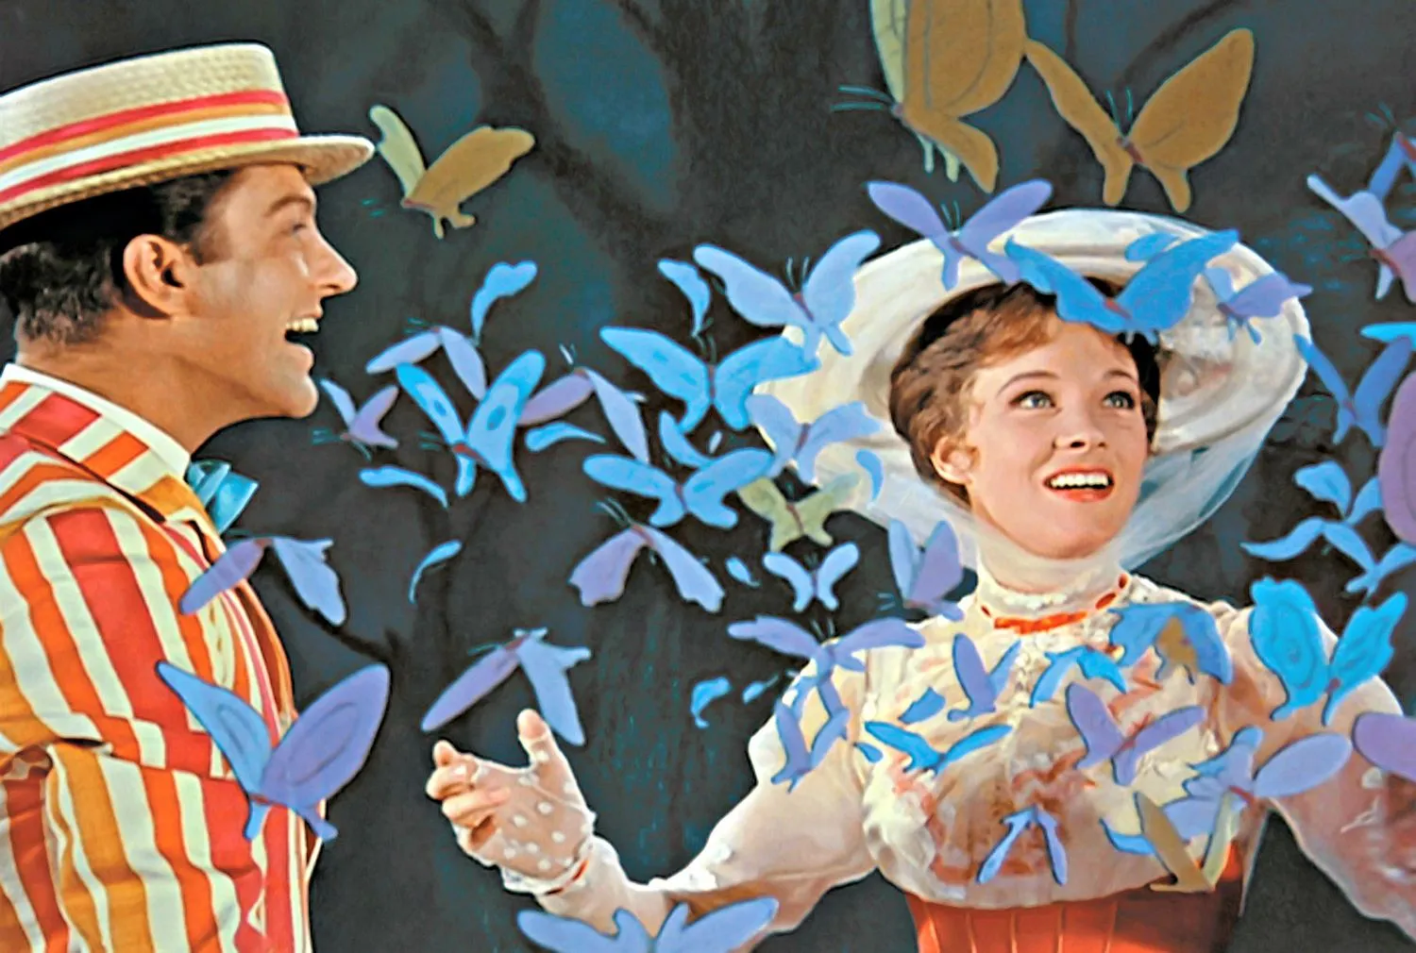
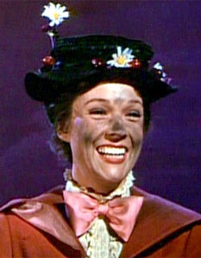
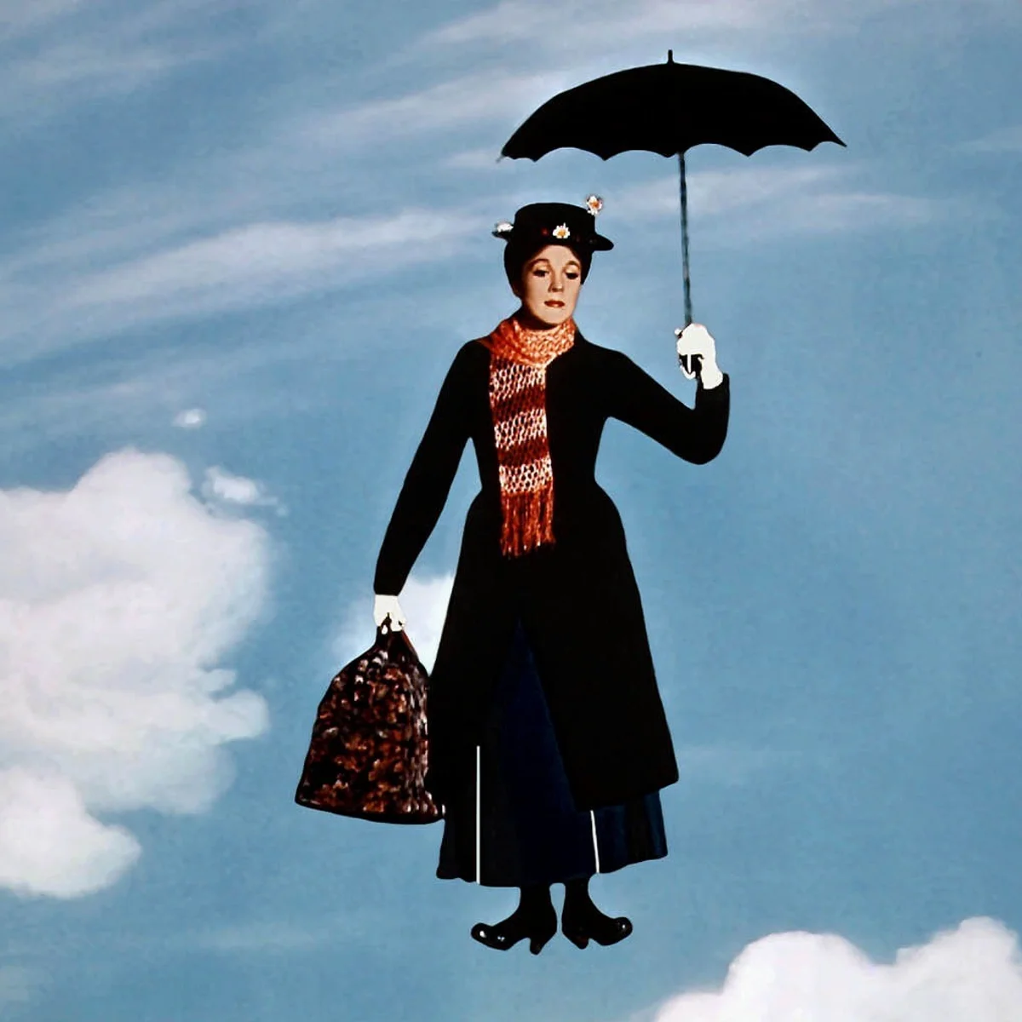
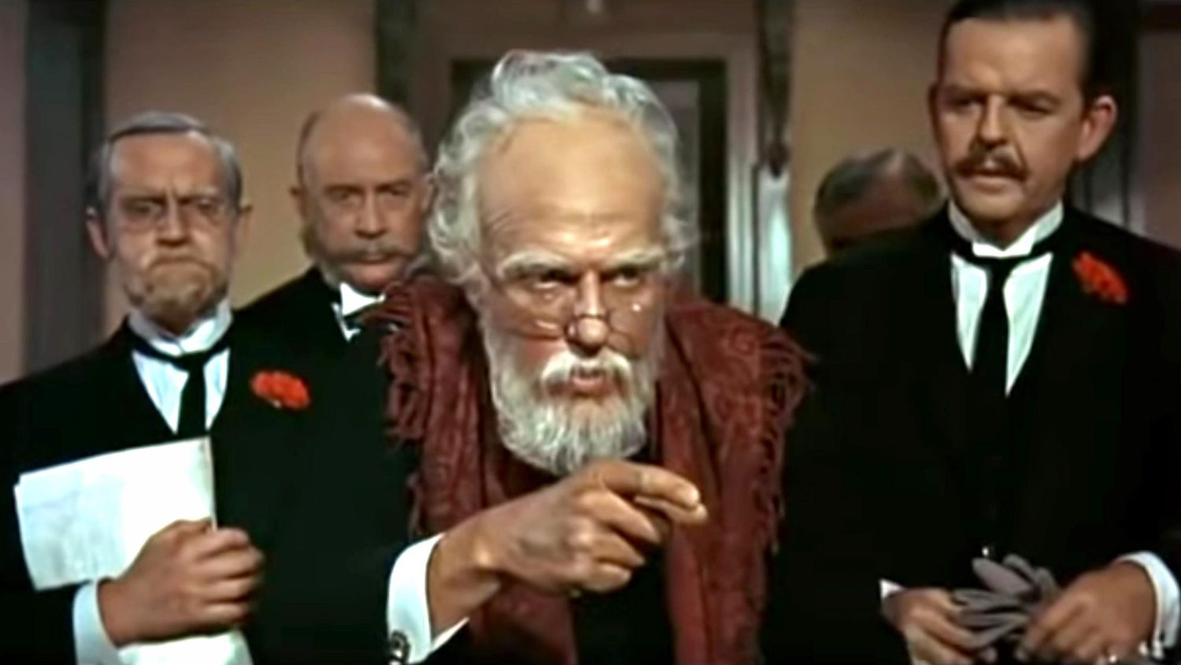
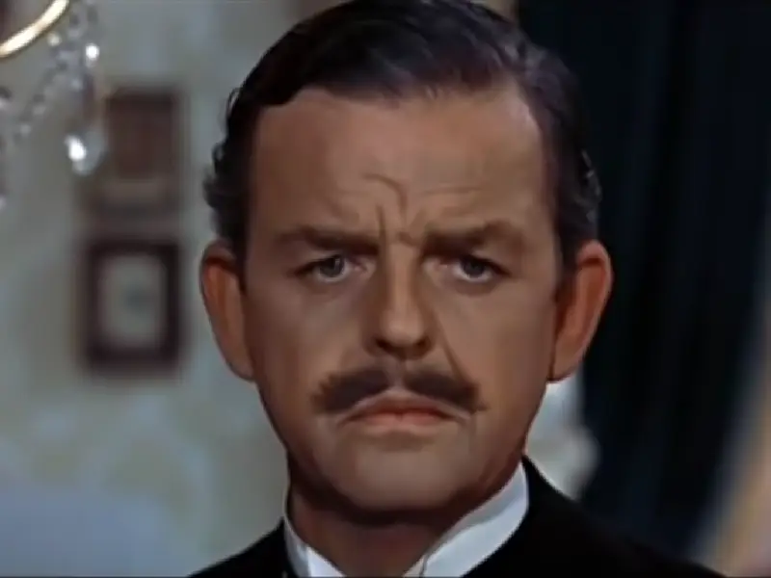
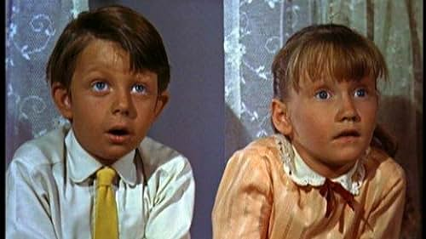
Subject: Performing Arts: Combined Dance and Drama
Topic: Musical Theatre: Mary Poppins Year: 8
Mary Poppins: Mary Poppins the musical is based on the similarly titled Mary Poppins children's books by P. L. Travers and the 1964 Disney film. The stage production is a fusion of various elements from the two, including songs from the film. Mary Poppins tells the story of a magical nanny that looks after two children in London. Key extracts include Step in Time and A Spoonful of sugar.
The stage production of Mary Poppins is set in London in the fascinating Edwardian era, with its class distinctions and rigid social norms.
Dance style: Musical theatre is less of a particular style, and more of a description of dancing that is rooted in the history of Broadway musicals. Relying heavily on a knowledge of ballet, tap, and jazz, musical theatre dancers are actors and place a high focus on musical interpretation. Tap dance is a type of dance that uses the sounds of tap shoes striking the floor as a form of percussion
The 5 Key skills/knowledge for this unit.
Accent: The way in which words are pronounced. For example, regional accents such as Yorkshire / Liverpudlian / Irish.
In Mary Poppins, Bert has a Cockney accent (London) “Cockney is the accent spoken in the East-End of London. It has been stigmatized for centuries but also has covert prestige, that is, it is a badge of identity for its speakers. Cockney is famous for its rhyming slang, much of which is humorous such as trouble and strife = wife.”
Mary Poppins
Accent
5
Themes
Facial Expression
Facial Expression: Facial expression is so important. An audience will look at body language for clues about a character, they do not just listen to the dialogue. Facial expression can reveal emotions and moods and can also tell us more about the situation. It can also reveal a sub-text
Body Language
Themes / Features:
• Guardian Angels
Hope
Kindness
• Musicality
• Use of Props
• Call and Response
Recommended Listening:
• Step In Time
Body Language: Body language is communication by movement or proxemics (position). Age, gender, culture and social status can be shown through body language. Gesture and facial expression are forms of body language.

Slide 2
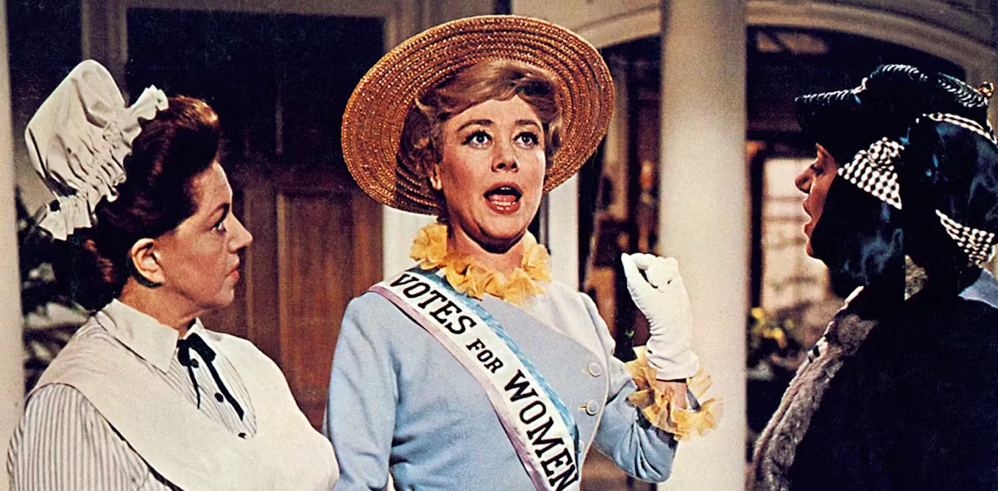
Context timeline – Mary Poppins is set in the Edwardian Age, the table below shows some key historical points of reference.
Mrs Banks is a Suffragette.
A Suffragette was “a member of an activist women's organisation in the early 20th century who, under the banner "Votes for Women", fought for the right to vote in public elections in the United Kingdom”
Sister Suffragette: https://www.youtube.com/watch?v=K0SDECwO54E

