Slide 1
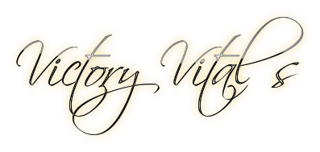
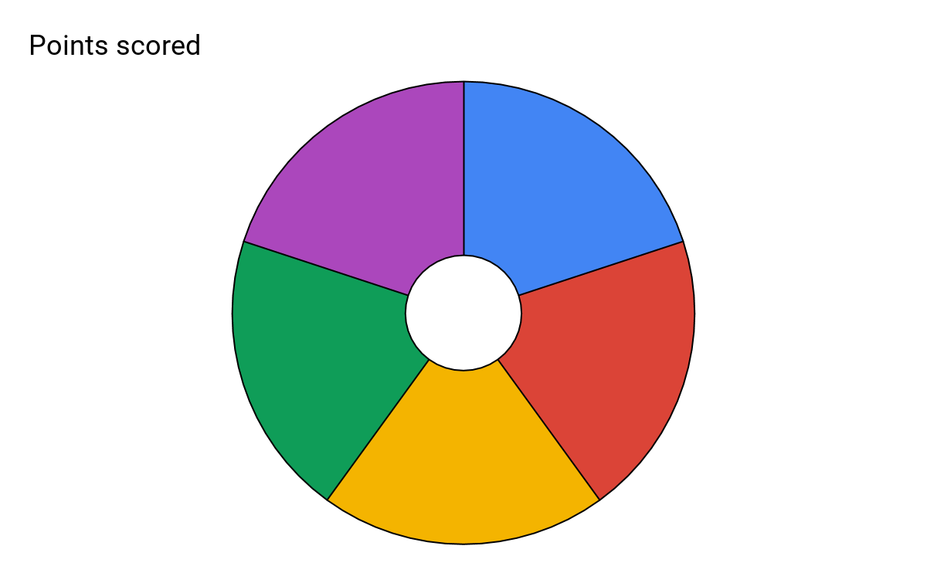
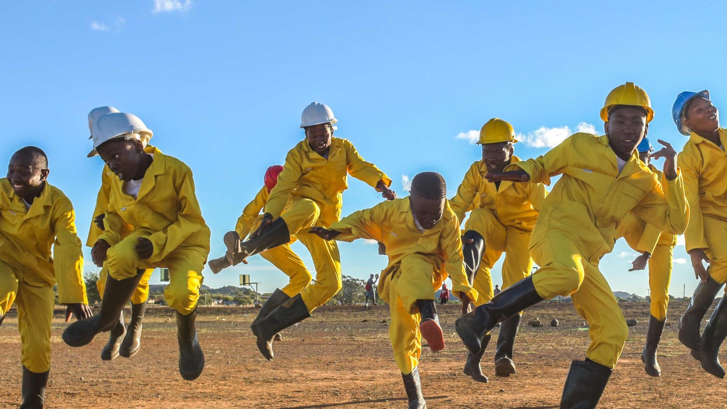
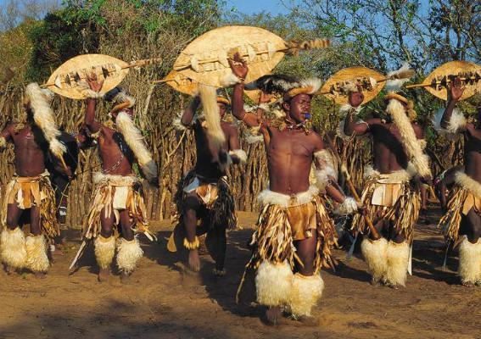
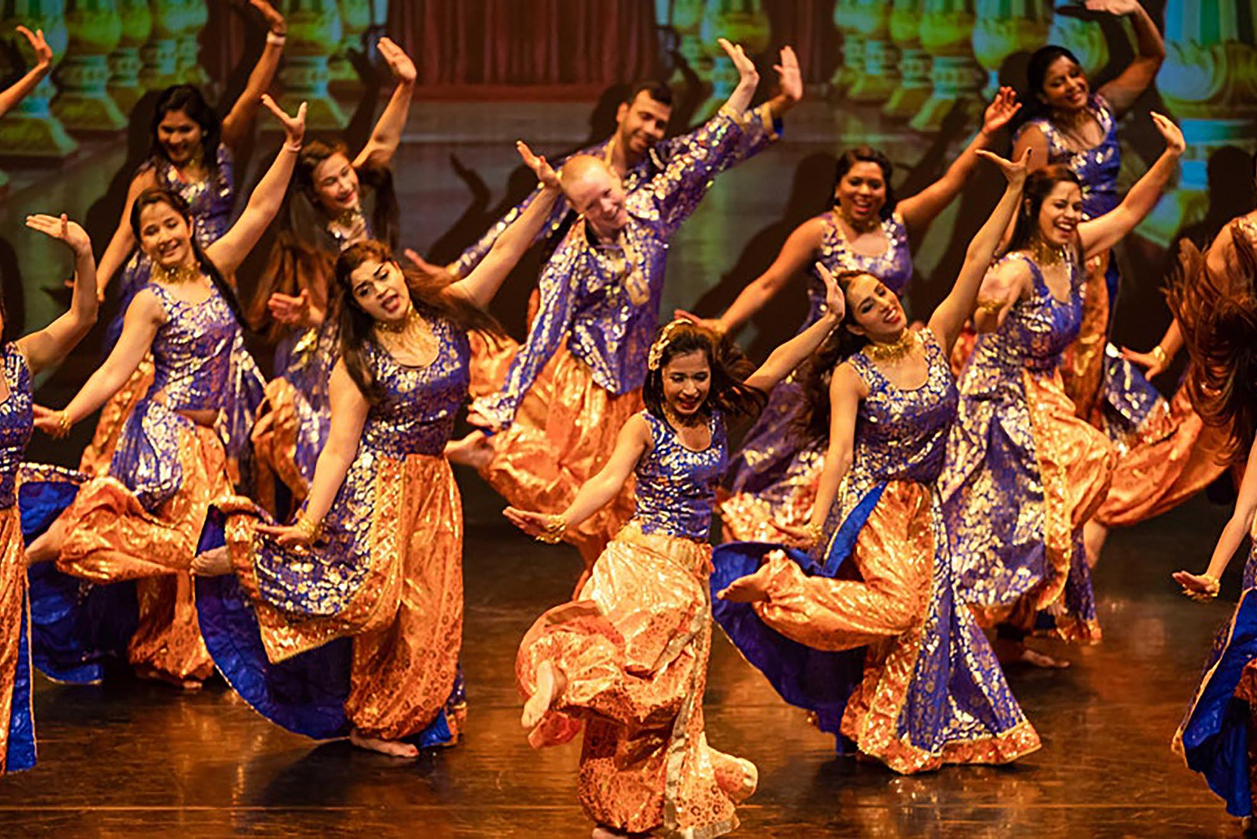
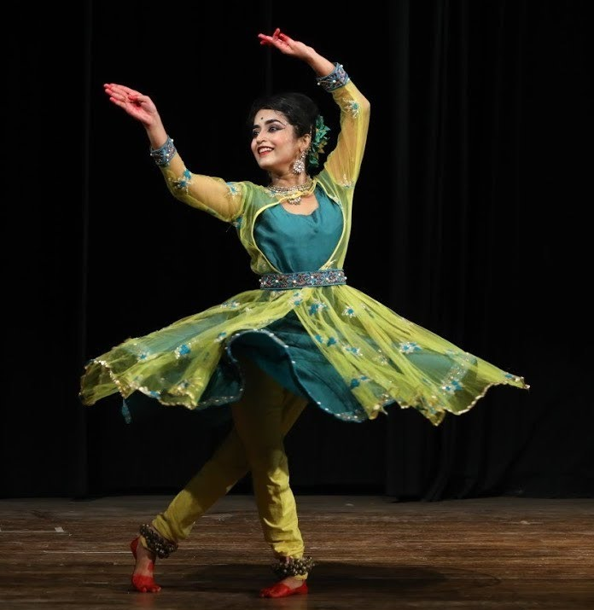
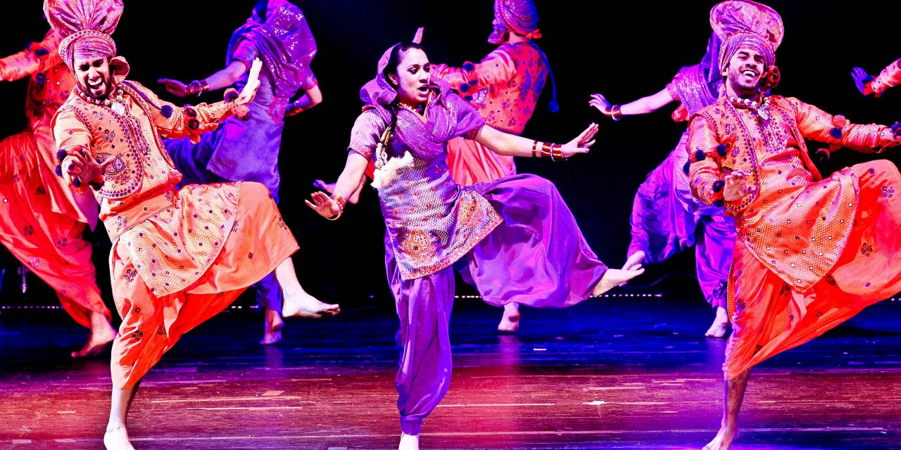
Subject: Performing Arts: Dance
Topic: World Dance Year: 9
Gumboot Dance: Gumboot dancing is a form of percussive dance that comes from South African workers who worked in the gold mines during the migrant labour system and oppressive Apartheid Pass Laws. Gumboot dancing has now been modernised in America and introduced to the street dance genre as Stepping.
Key Features:
Making sounds with the body
Call and response
Stomping/ Clapping
Spoken word
The 5 Key skills/knowledge for this unit.
African Dance: African Dances are largely vernacular dances, they teach social patterns and values, help people work, mature, praise or criticize members of the community while celebrating festivals and funerals, competing and reciting history. African dances are largely participatory, with spectators being part of the performance.
Key Features:
Polyrhythms
Call and response
Emphasis is placed on the chest hips and knees.
Performed in groups
Gumboot Dance
African Dance
5
Bollywood
Kathak
Bollywood: Bollywood dance is the dance-form used in Indian films. It is a mixture of numerous styles. These styles include belly-dancing, kathak, Indian folk, western popular, and modern jazz dance. Bollywood dance has evolved to be a unique and energetic style that often tells a story.
Key Features:
Neck & Head movements
Facial expressions
Hand Gestures
Group formations
Bhangra
Kathak: Kathak is a traditional form of Indian dance that tells a story The technique is built by the use of an intricate use of footwork, soft gliding movements of the neck, eyebrows, and the wrists. Recitation of the rhythmic syllables (counting out loud) is common. The music is usually played live on stage by an accompanying musician.
Key Features:
Hand Gestures/Mudras
Storytelling/Narrative Structure
Intricate footwork
Precise Rhythmic Patterns
Bhangra: Bhangra is a folk style of dance that originated in India. The dance was associated primarily with the spring harvest festival Vaisakhi. In a typical performance, several dancers execute vigorous kicks, leaps, and bends of the body, to the beat of a dhol which is a double headed drum.
Key features:
Traditionally performed in a circle
Seasonal Dance
Energetic style
Lots of jumps

Slide 2
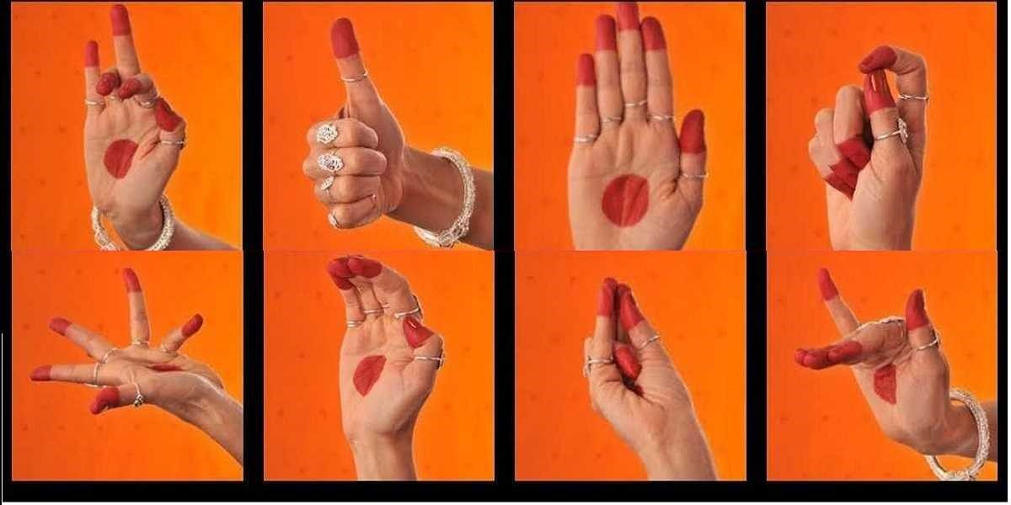
Subject: Performing Arts: Dance
Topic: World Dance Year: 9
What is World Dance? World dance consists of a variety of dance styles from all over the world. The dances are usually performed or practiced as part of a countries culture or social setting.
What is a vernacular dance? Vernacular dances are dances which have developed 'naturally' as a part of 'everyday' culture within a community.
What are choreographic devices? Choreographic devices are the tools that we use to develop our choreography to make it more original and interesting.
Key Vocabulary: Choreographic Devices
Keyword | Definition
Canon | Performing the same movement one after another.
Unison | Performing the same movement at the same time
Formation | The position you stand in to perform.
Levels | The height at which you perform your movement
Mirroring | Dancers to do the same travel, jump, shape, or balance at the same time to produce the illusion of a mirror image
Retrograde | Performing a phrase backwards
Call and Response | A dancer performs a phrase or a ‘call’ and another dancer responds with movement. A conversation through dance.
Accumulation | Gaining dancers as a phrase is performed
Juxtaposition | Showing a contrast on stage. This can be applied using speed or style etc
Fragmentation | Dividing the dance into smaller chunks and reordering this to create a new phrase
Key Vocabulary: Physical and Performance Skills
Keyword | Definition
Extension | The lengthening of body parts outwards. E.g. Straight arms and pointed toes
Flexibility | The range of movement possible in the joints/muscles
Coordination | The ability to use different parts of the body together smoothly and efficiently.
Posture | The way the body is held
Stamina | Ability to maintain physical and mental energy over periods of time.
Timing | Performing the correct movement at the correct time. This should be in time with your group
Musicality | How in time you are with the music
Energy | How much physical effort you apply to the performance
Facial Expressions | Animating the face to engage with your audience/communicate the theme of your performance
Projection | Projecting your movements outwards into the space with appropriate energy.
Dynamic Awareness | Noticing and applying the correct quality to each movement. For example: sharp, soft, fluid etc.
How do Kathak dancers tell a story to the audience? Hand gestures are used to engage the audience and to tell a story
What hand gestures/Hasta Mudras are used? In total there are 55 Hasta Mudras used to form the base for all story telling performances.

