Slide 1
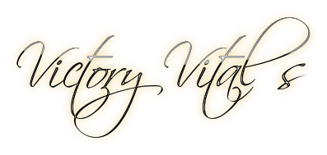
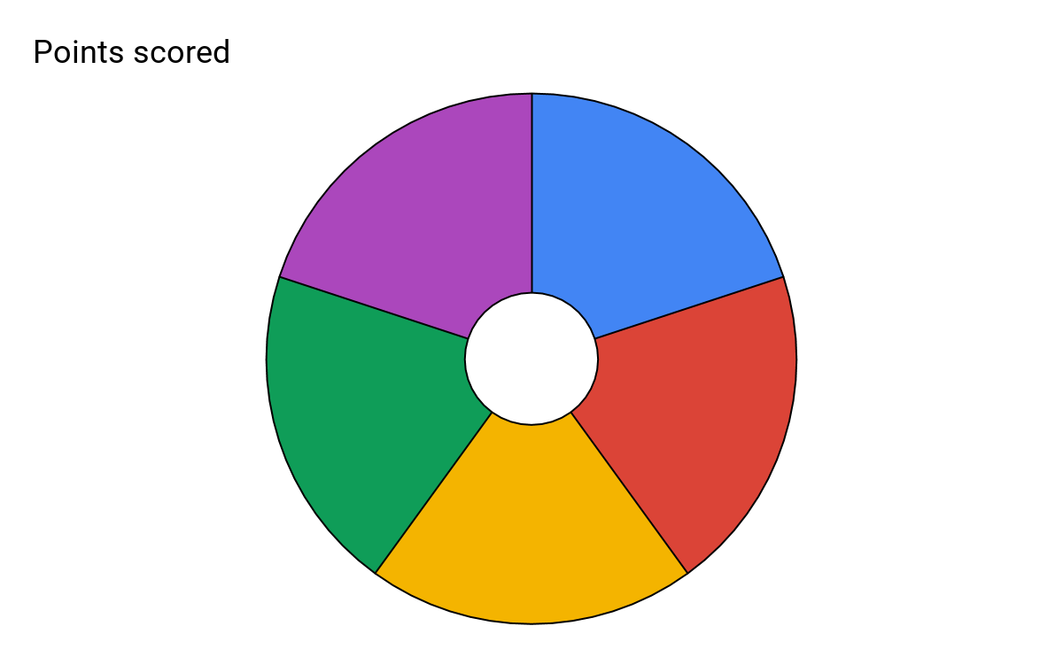
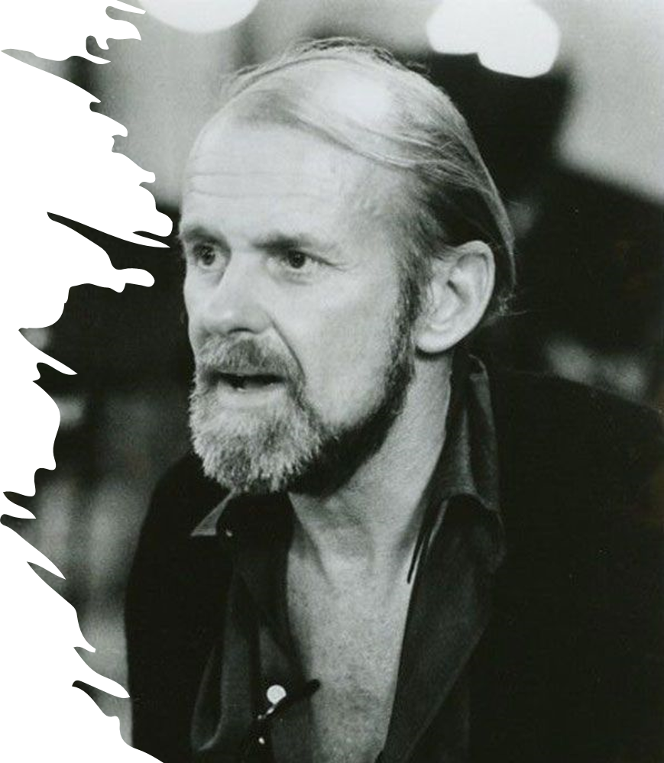
Subject: Performing Arts Year 9 Spring 1
Topic: Dance Practitioner: Bob Fosse
Isolation:
Is a core Fosse Feature which crosses over to other popular styles of dance. It when one part of the body moves at a time, this can be combined with other body parts.
In Autumn One we explored isolation in Street Dance.
The 5 key skills/knowledge for this unit.
Rolls:
Rolls are a common feature used in Fosse choreography in a variety of ways, there are rolls of the wrists, shoulders and hips. These can be small subtle movements but when done correctly work together with isolations to elevate the quality of performance.
Isolation
Rolls
Fosse Facts:
Fosse grew up around show business primarily in Vaudeville.
Fosse's second wife encouraged him to pursue a career as a choreographer.
Fosse brought Jazz Hands into the limelight. Although they probably existed long before him, when he directed and choreographed the 1972 musical Pippin, he had the opening number filled with hand movements.
Fosse is the only person to have won an Emmy, Tony and Academy Award for direction in the same year.
In 1983 Fosse turned down the offer to direct the music video for Thriller.
5
Accuracy
Turned In Knees / Feet
Extension
Accuracy:
Accuracy is when a movement is executed in the way the choreographer intended. Consider if the level of energy or power behind the move is powerful enough.
With Fosse we talk about stretching the muscles to elongate the limbs and emphasise what appears to be a small movement.
Extension:
Extension is where you fully commit to the execution of a movement and push your body as far as it can possibly go.
For example, in the Fosse Features we talk about splayed fingers (Jazz hands) and how we elongate the appearance of our hands by stretching the muscles.
Turned in Knees / Feet:
Fosse liked to highlight features that would commonly be insecurities for people and said himself that he didn't have what "Ballet dancers call a turn out." So, he started to angle his knees and feet inwards to create more abstract shapes.

